Slide 1
The Blockchain Myths:
Blockchain ≠ Bitcoin (or any other cryptocurrencies)
The legal issues of cryptocurrencies are not covered during this course
Anything and everything in the world cannot be solved by using the blockchain technology
Blockchain cannot change the society in a week or month or year
We cannot replace the traditional data with the blockchain

Slide 2
What exactly “Blockchain” is:
Start with few stories analogous (similar) with computer domain
=-=-=-=-=-=-=-=-=-=-==-=--==-=-=-=--==-=-=-=-=-=-=-=-=-=-=-=-=-=-=-=-=-=-=-=-=
Story 1:- Scenario related to centralized computing
Disadvantage: 1. Single point of failure (SPoF) problem
2. Trust issues
3. No transparency
=-=-=-=-=-=-=-=-=-=-==-=--==-=-=-=--==-=-=-=-=-=-=-=-=-=-=-=-=-=-=-=-=-=-=-=-=
Story 2:- Scenario related to decentralized computing
Disadvantage: 1. Still Trust issues
2. Little transparency
No single control means- decentralized

Slide 3
What exactly “Blockchain” is:
Start with few stories analogous (similar) with computer domain
=-=-=-=-=-=-=-=-=-=-==-=--==-=-=-=--==-=-=-=-=-=-=-=-=-=-=-=-=-=-=-=-=-=-=-=-=
Story 3:- Scenario related to distributed computing
Advantage: 1. No SPoF problem
2. No Trust issues
3. Full transparency
This is the analogous to peer-to-peer architecture “Blockchain”.
Nodes can be geographically located.

Slide 4
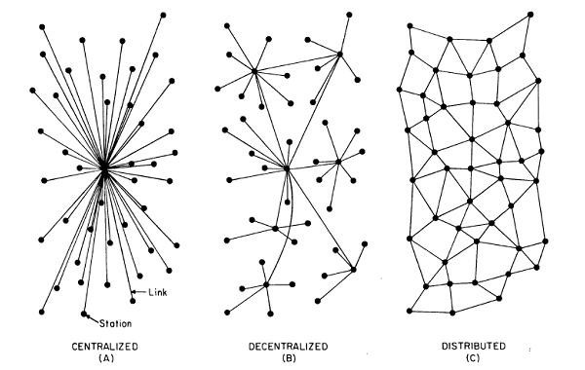
Centralized vs Decentralized vs Distributed System

Slide 5
Centralized System
Complete reliance on single point
It is a central coordination system.
Every node connecting to central coordinator.
Whatever information nodes want to share, the information will be shared by this central coordination system.
Under this platform you have a problem like, if this central coordination platform fails then all of these individual nodes they will get disconnected. (Remember SPOF Problem)

Slide 6
Decentralized System
Multiple Points of coordination
In the decentralized system consists of more than one coordinator.
All these coordinator cooperative with each other and the individual nodes are connected to these coordinator.
What is the case when more than one node are failed:
So, in this particular architecture, if this particular node fails or multiple node fails then this coordinators can connect to another individual nodes or can connect to another coordinator and can share the information and perform the operation using those available coordinators.

Slide 7
Decentralized System (Contd..)
Advantages
Still tolerate multiple number of failures, until the network becomes disconnected
Disadvantages
if the network get partitioned or the network get disconnected then this individual nodes will not be able to cooperate with each other.

Slide 8
Distributed System
Every one execute the job
In distributed system, all the nodes are participated in the computation or the information sharing process or in the application development.
Blockchain is a platform which supports the decentralized platform or a distributed platform for sharing the information.
=-=-=-=-=-=-=-=-=-=-==-=--==-=-=-=--==-=-=-=-=-=-=-=-=-=-=-=-=-=-=-=-=-=-=-=-
“Which platform is good- is depends on the type of application”
=-=-=-=-=-=-=-=-=-=-==-=--==-=-=-=--==-=-=-=-=-=-=-=-=-=-=-=-=-=-=-=-=-=-=-=-
Blockchain is a decentralized distributed network.
Based on the applications, we use the decentralized (or) distributed features.

Slide 9
History of Blockchain
Blockchain 1.0
=-=-=-=-=-=-=-=-=-=-==-=--==-=-=-=--==-=-=-=-=-=-=-=-=-=-=-=-=-=-=-=-=-=-=-=-=
1991- A cryptographically secured chain of blocks is described for the first time by Stuart Haber and W Scott Stornetta.
1998-Computer scientist Nick Szabo works on ‘bit gold’, a decentralised digital currency.
2000-Stefan Konst publishes his theory of cryptographic secured chains, plus ideas for implementation.
2008-Developer(s) working under the pseudonym Satoshi Nakamoto release a white paper establishing the model for a blockchain (Solve the problem of double spending).
“Remember the Global Financial Crisis occurred in 2008-09”
2009-Nakamoto implements the first blockchain as the public ledger for transactions made using bitcoin.

Slide 10
History of Blockchain (Contd..)
Blockchain 2.0
=-=-=-=-=-=-=-=-=-=-==-=--==-=-=-=--==-=-=-=-=-=-=-=-=-=-=-=-=-=-=-=-=-=-=-=-=
2014 - Hundreds of currencies were made
In 2013 Ethereum was developed to think beyond cryptocurrencies
“Cryptocurrencies to Smart contracts”
2015 - Hyperledger- an enterprise blockchain (for business processes)
Linux foundation

Slide 11
History of Blockchain (Contd..)
Blockchain 3.0
=-=-=-=-=-=-=-=-=-=-==-=--==-=-=-=--==-=-=-=-=-=-=-=-=-=-=-=-=-=-=-=-=-=-=-=-=
2018 – Use smart contracts (or hyperledger) to build decentralized applications like in Healthcare, Supply chain, Finance, etc.
Future of blockchain-
2022-23: 10 billion dollar
2025-26: 176 billion dollar
2030-31: 3 trillion dollar

Slide 12
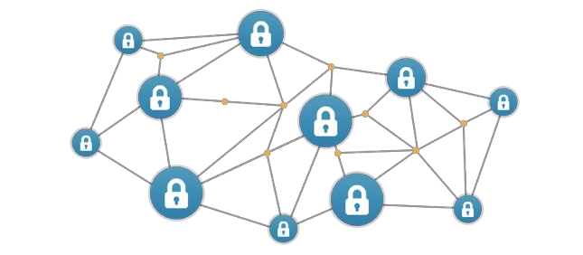
What is a Blockchain
A Decentralized computation and information sharing platform that enables multiple authoritative domains, who do not trust each other, to cooperate, coordinate and collaborate in a rational decision making process. Additionally, a blockchain is a cryptographically secured record of transactions stored on decentralized network where each block contains the various transactions which are approved after complex consensus algorithms.

Slide 13
Remember Keywords in a definition:-
Decentralized
Computation and information sharing platform
Multiple authoritative domains
Trust
Cooperate, coordinate and collaborate in a rational decision making process
Cryptographically secured record of transactions
Consensus algorithms

Slide 14
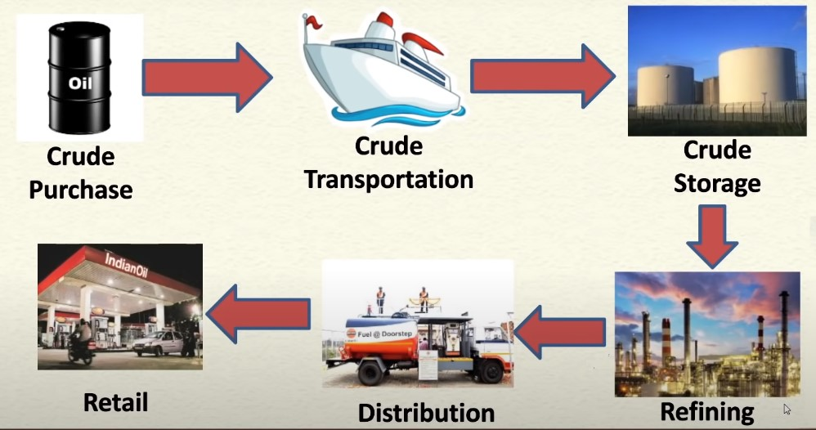
An Example- Supply chain in petroleum industry
Objective: Each stakeholder wants to maximize its profit-margin

Slide 15
Contd…
To fulfils this objective, it is required to need strong co-ordination among all the stakeholder.
But, the problem is each stakeholder has its own governing structure and taking the decision on its own way.
So, the question arises, how to obtain the real-time information from these stakeholders.
One solution is to use “web-portal”, But there is no central platform present in the supply chain because it is completely working on decentralized way.
Therefore, we need a decentralized solution where no one trust each other. But, they should cooperate.

Slide 16
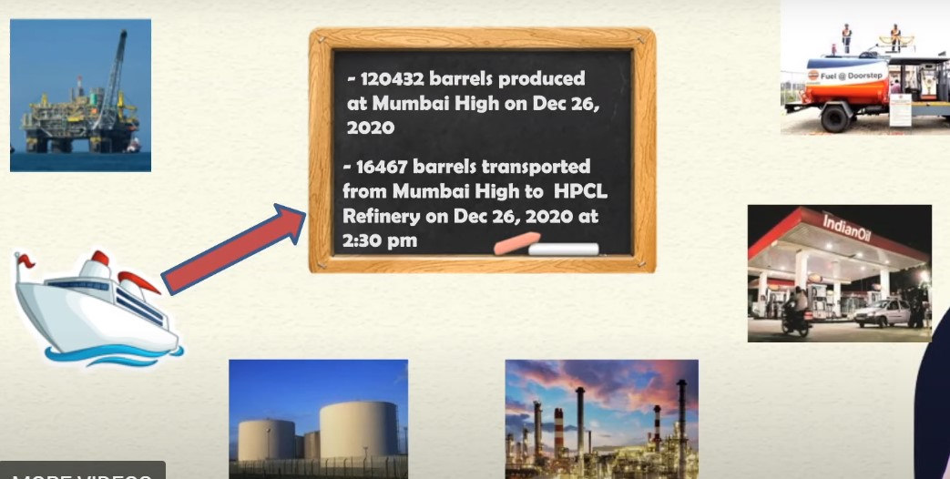
One possible solution: Use of bulletin board

Slide 17
Properties of bulletin board :-
The board has infinite space. You do not need to erase anything.
Everyone can see the logs and verify it.
Any change in the information is visible to everyone.
The board is not erasable, no one can deny later.
Simple one-step auditing.
=-=-=-=-=-==-==-=-=-=-=-=-=-==-=-=-=-=-=-=-=-=-=-=-=-=-=-=-=-=-=-==-=-=-=-
Question- Who will maintain this bulletin board?
Answer- Let everyone maintain the same copy of the board individually and independently.

Slide 18
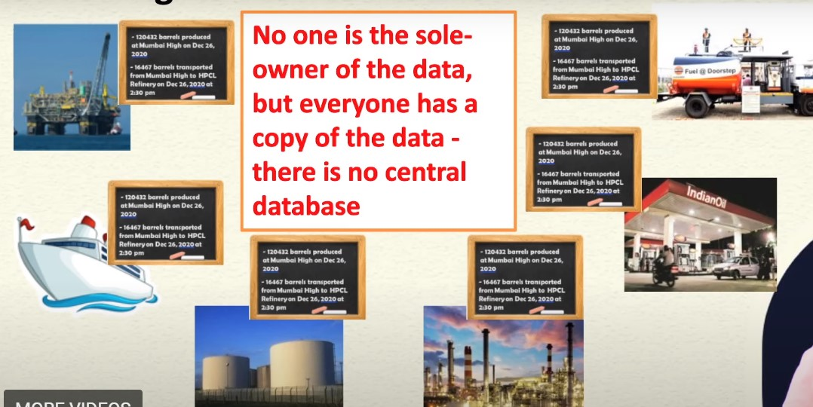
Possible Solution- Notion of Blockchain technology

Slide 19
A very simplified look of the Blockchain
Every node maintains a local copy of the global data-sheet.
The system ensures consistency among the local copies.
The local copy at every node is identical.
The local copies are always updated based on the global information.
Public-ledger

Slide 20
A very simplified look of the Blockchain (Contd..)
Public ledger is a database of all the historical information which is available to everyone.
The historical information may be utilized for the future computation.
For example, in the banking system, historical transaction are the banking transaction where old transactions are used to validate the new transactions.
Public-ledger

Slide 21




An example of public ledger in the banking sector
Alice:100$
Alice:100$
Public ledger
of Alice
Public ledger
of Bob
100$
Bob
Alice
Alice:100$
Public ledger
of Eve
Alice:100$
Public ledger
of Jane
Eve
Jane

Slide 22
An example of public ledger in the banking sector
Alice:100$
50$
Alice:100$
Public ledger
of Alice
Public ledger
of Bob
100$
Bob
Alice
Alice:100$
Public ledger
of Eve
Alice:100$
Public ledger
of Jane
Eve
Jane

Slide 23
An example of public ledger in the banking sector
Alice:100$
50$
Alice:100$
Alice -> Bob:50 $
Alice -> Bob:50 $
100$
Bob
Alice
Alice:100$
Alice -> Bob:50 $
Alice:100$
Alice -> Bob:50 $
Eve
Jane

Slide 24
An example of public ledger in the banking sector
Alice:100$
Alice:100$
Alice -> Bob:50 $
Alice -> Bob:50 $
100$
Bob
Alice
30$
Alice:100$
Alice -> Bob:50 $
Alice:100$
Alice -> Bob:50 $
Eve
Jane

Slide 25
An example of public ledger in the banking sector
Alice:100$
Alice:100$
Alice -> Bob:50 $
Alice -> Bob:50 $
100$
Bob
Alice
Bob -> Eve:30 $
Bob -> Eve:30 $
30$
Alice:100$
Alice -> Bob:50 $
Alice:100$
Alice -> Bob:50 $
Bob -> Eve:30 $
Eve
Jane
Bob -> Eve:30 $

Slide 26

An example of public ledger in the banking sector
Alice:100$
Alice:100$
Alice -> Bob:50 $
Alice -> Bob:50 $
100$
Bob
Alice
Bob -> Eve:30 $
Bob -> Eve:30 $
80$
Alice:100$
Alice -> Bob:50 $
Alice:100$
Alice -> Bob:50 $
Bob -> Eve:30 $
Eve
Jane
Bob -> Eve:30 $

Slide 27
Formal definition of Blockchain
A Blockchain is an open, distributed ledger that can record the transactions between two parties efficiently and in a verifiable and permanent way.
Keywords
Open – Accessible to all.
Distributed- No single party.
Efficient- fast
Verifiable- everyone can check the validity of information.
Permanent- the information is persistent.

Slide 28
Key characteristics of Blockchain
Decentralization
Immutability
Public ledger
Transparency
Anonymity
Openness
Validation (Consensus)

Slide 29
Key characteristics of Blockchain (Contd..)
Decentralization
In the blockchain, central authority or trusted third party are not present.
SPOF problem can not arise in the blockchain.

Slide 30
Key characteristics of Blockchain (Contd..)
Immutability
Once the digital asset stored in the blockchain network, no one can modify or delete it.
Digital assets (or block) are stored in the chronological order.
The cryptographic Hash functions are used to connect the blocks.

Slide 31
Key characteristics of Blockchain (Contd..)
Public ledger
Each node in the blockchain, stores the transactions in his/her public ledger.
The same public ledger is available with every node.
To added a new transaction in the public ledger, majority of nodes are agree that the new transaction is a valid transaction.

Slide 32
Key characteristics of Blockchain (Contd..)
Transparency
All the nodes are having the same and updated copy of the public ledger.
Therefore the complete transparency is maintained in the blockchain network.

Slide 33
Key characteristics of Blockchain (Contd..)
Anonymity
Each user can interact with the blockchain with a generated address, which does not reveal the real identity of the user.
Therefore anonymity is preserved in the blockchain.

Slide 34
Key characteristics of Blockchain (Contd..)
Validation
A new transaction is validated by the more number of peer nodes.
After the successful validation, it is added in the blockchain.
Consensus protocol are used for validation.

